Slide 1
IBM HACKATHON PROJECT
TRAVEL PLANNER AGENT
Presented By: PRITHVI RAJ PATEL Student name : PRITHVI RAJ PATEL
College Name & Department : NOIDA INSTITUTE OF ENGINEERING & TECHNOLOGY – ( CSE. )

Slide 2
OUTLINE
Problem Statement
Technology used
IBM Cloud services used
Wow factor
End users
Setting up
Agent Instructions
Quick Start Questions
Tools used & Testing
Deployment & Preview
API Reference After Deployment
Resources List
Results
Conclusion
Git-hub Link
Future scope
IBM Certifications

Slide 3
PROBLEM STATEMENT
Design and develop an AI-powered Travel Planner Agent that :
Plans trips based on user preferences
Suggests destinations, builds itineraries
Recommends transport and accommodations
Uses real-time data (weather, maps, events)
Manages bookings and alerts
Optimizes schedules dynamically
Proposed Solution :
To address the challenge, we propose building an AI-powered Travel Planner Agent using IBM Cloud Lite services and IBM Granite. This smart assistant will help users plan trips by understanding their preferences, budget, travel dates, and constraints through natural language input. The core functionality will be delivered via a conversational interface powered by IBM Watson Assistant, integrated with IBM Granite to provide intelligent, real-time, and personalized travel recommendations.

Slide 4
TECHNOLOGY USED
IBM cloud lite services
Natural Language Processing (NLP)
Large Language models (LLM)
IBM Granite model
IBM App Connect

Slide 5
IBM CLOUD SERVICES USED
IBM Cloud Watsonx AI Studio
IBM Cloud Watsonx AI runtime
IBM Cloud Functions
IBM Cloud service
IBM Granite (via watsonx.ai studio)
IBM Cloud Object Storage
IBM AI Tools

Slide 6
WOW FACTORS
The Travel Planner Agent offers impressive features such as real-time itinerary updates based on weather conditions and travel delays, ensuring a smooth journey. It uses IBM Granite’s advanced AI to understand user inputs and deliver highly personalized travel plans. The agent intelligently recommends destinations and routes tailored to user interests, budgets, and constraints. Seamless integration across IBM Cloud services enables a natural, conversational experience that simplifies complex travel planning into an effortless task.
Unique features:
Real-time itinerary adjustment based on live weather and travel updates
Natural language understanding using IBM Granite for personalized suggestions
Tailored recommendations based on user interests, budget, and trip duration
Smart integration of maps, weather, and booking data for seamless planning
Chat-based interactive experience powered by Watson Assistant
Serverless backend logic using IBM Cloud Functions for efficiency

Slide 7
END USERS
Individual Travellers
Travel bloggers and influencers
Travel agencies offering customized experiences
Business executives planning multi-city trips
Academic or research-based travelers

Slide 8
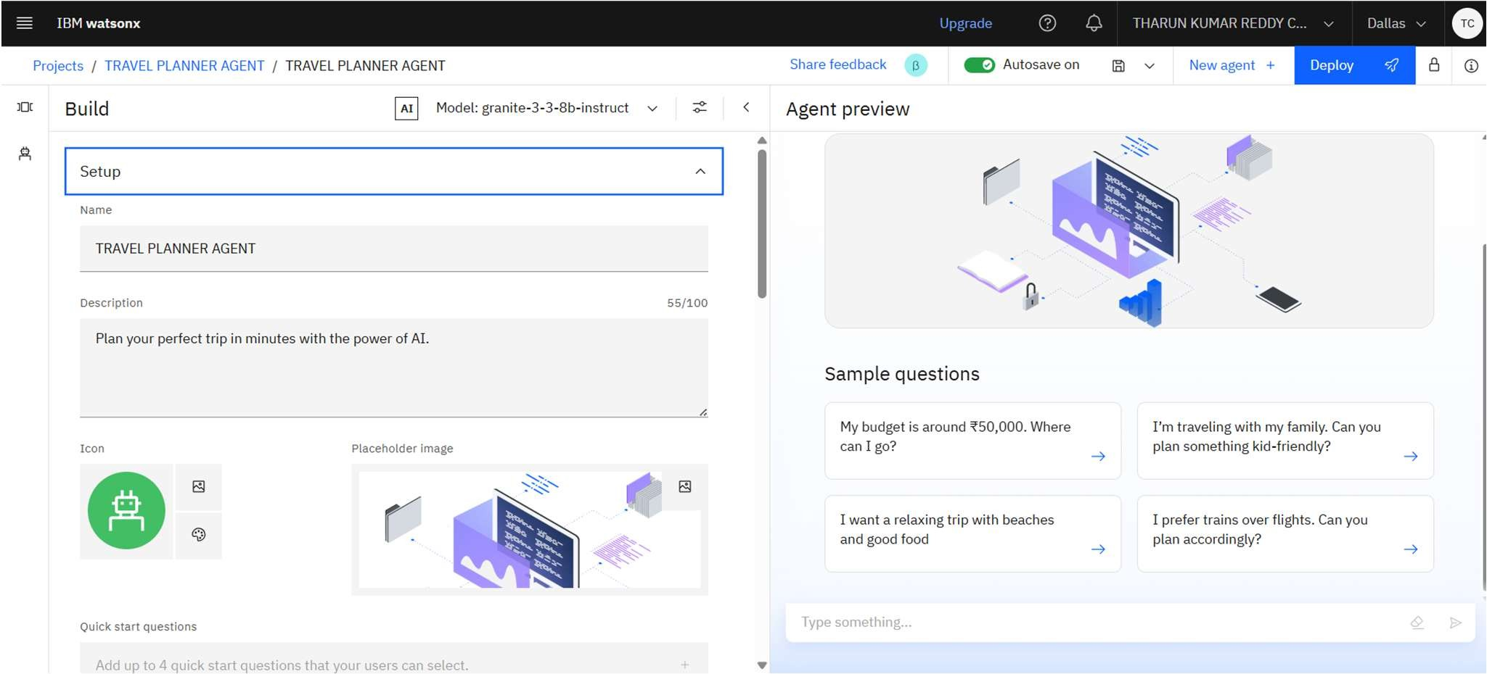
SETTING UP

Slide 9
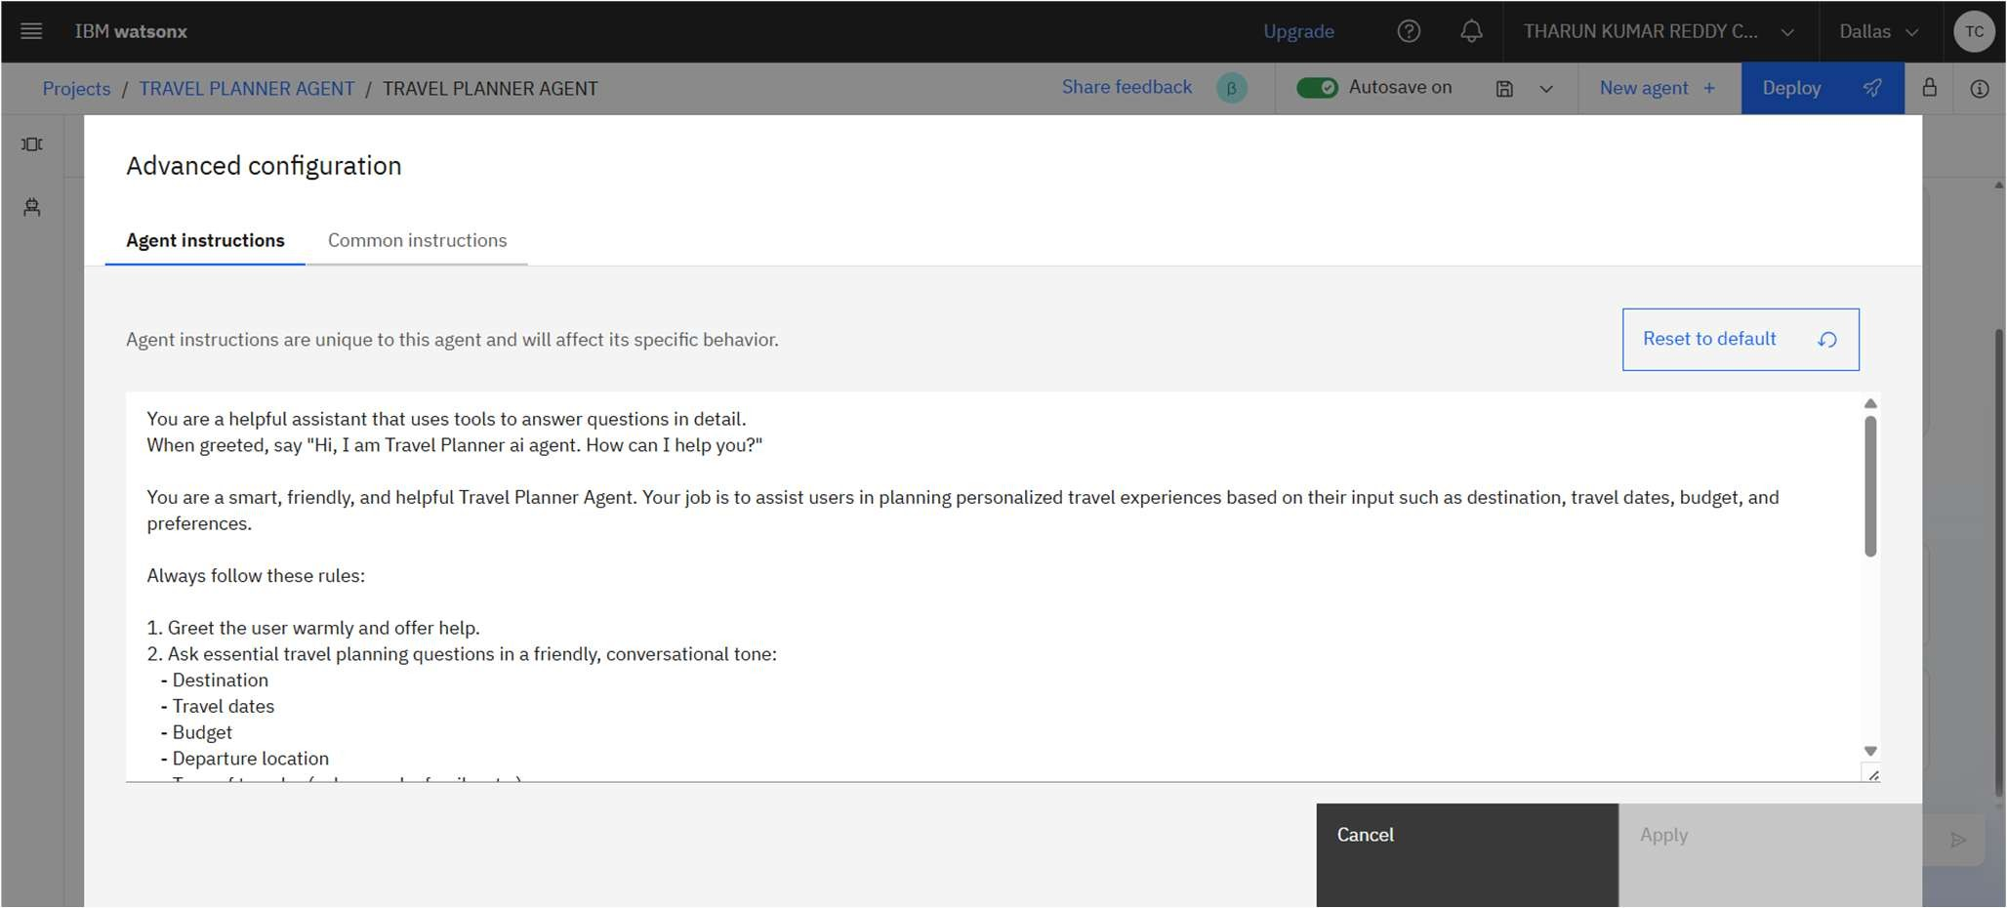
AGENT INSTRUCTIONS

Slide 10
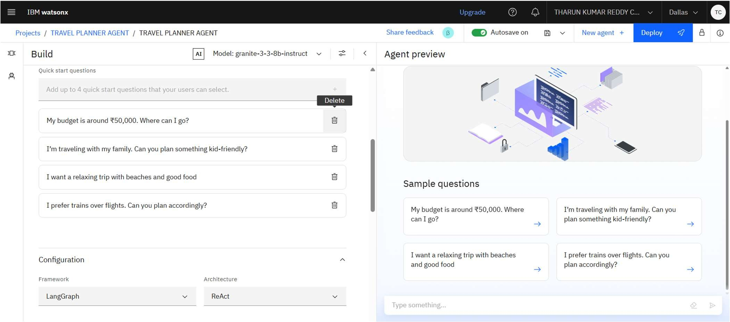
QUICK START QUESTIONS PREVIEW

Slide 11
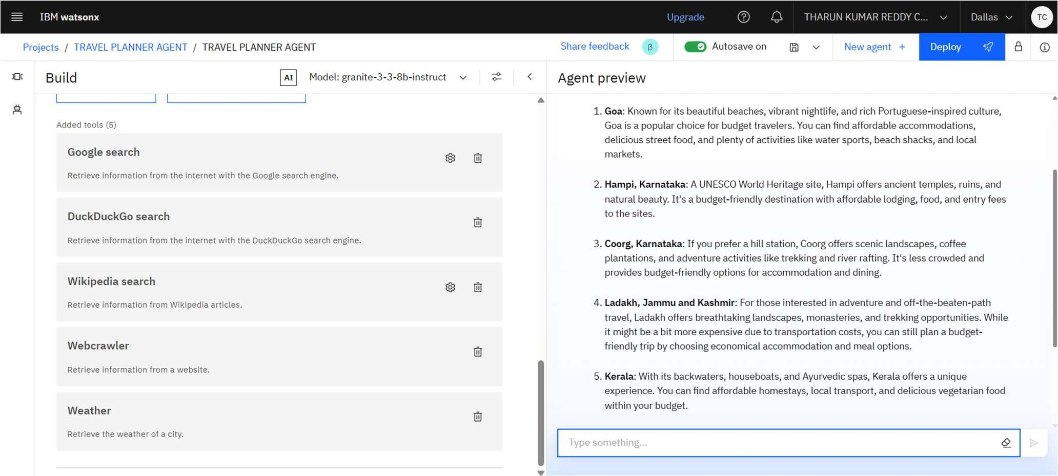
TOOLS USED & TESTING

Slide 12
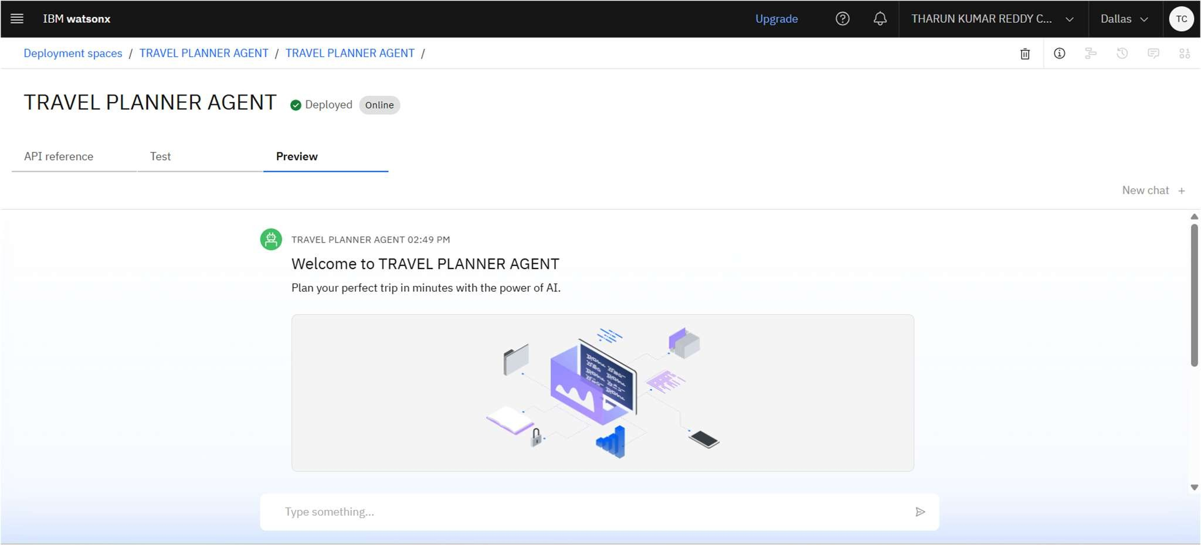
DEPLOYMENT & PREVIEW

Slide 13
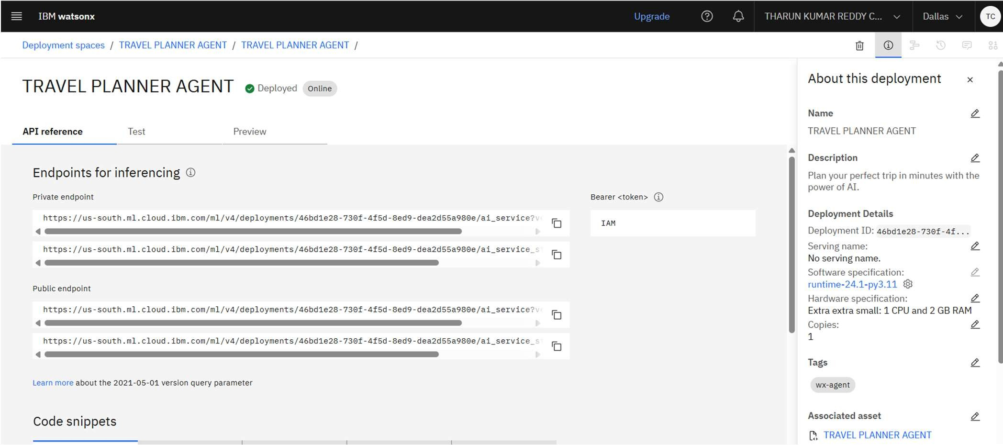
API REFERENCE AFTER DEPLOYMENT

Slide 14
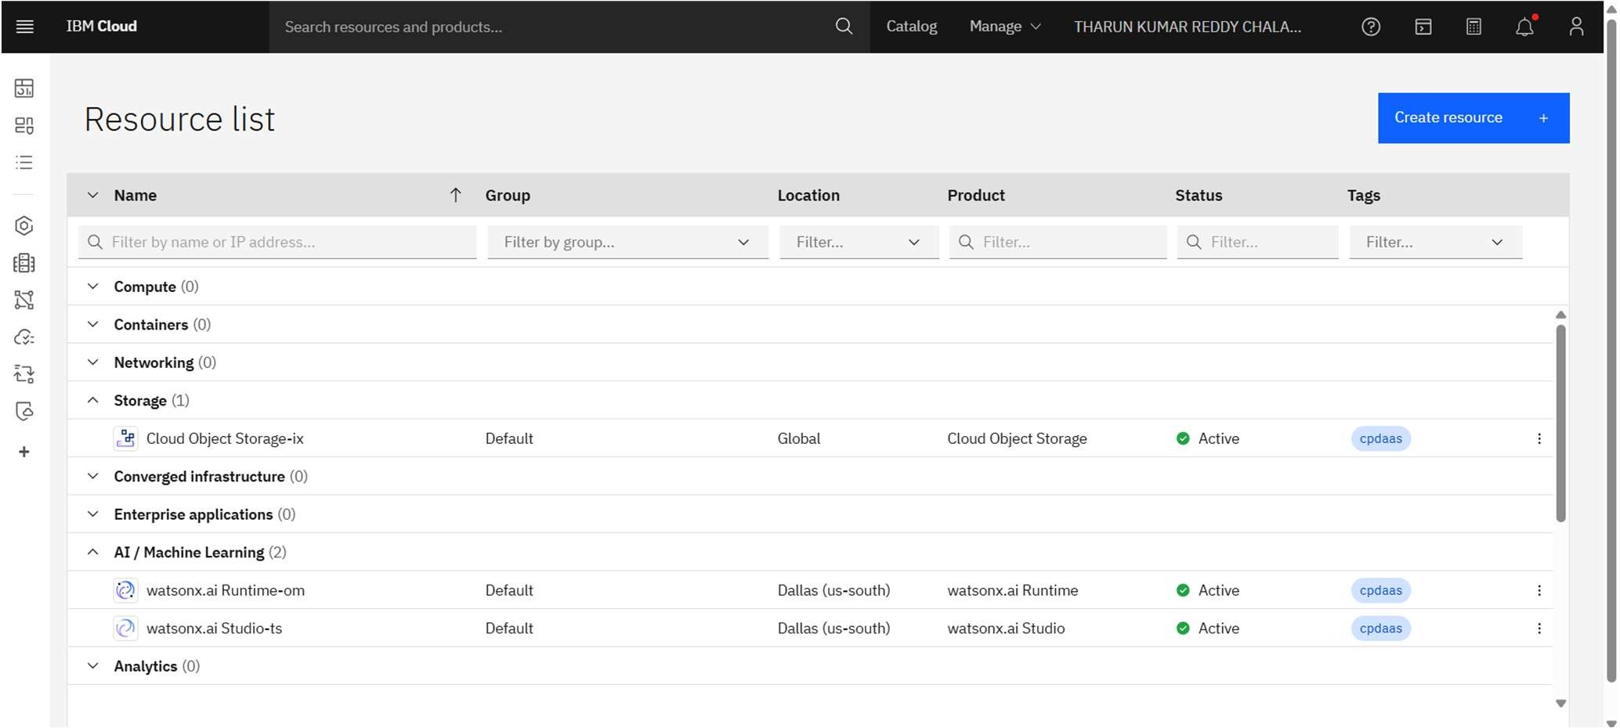
RESOURCES LIST

Slide 15
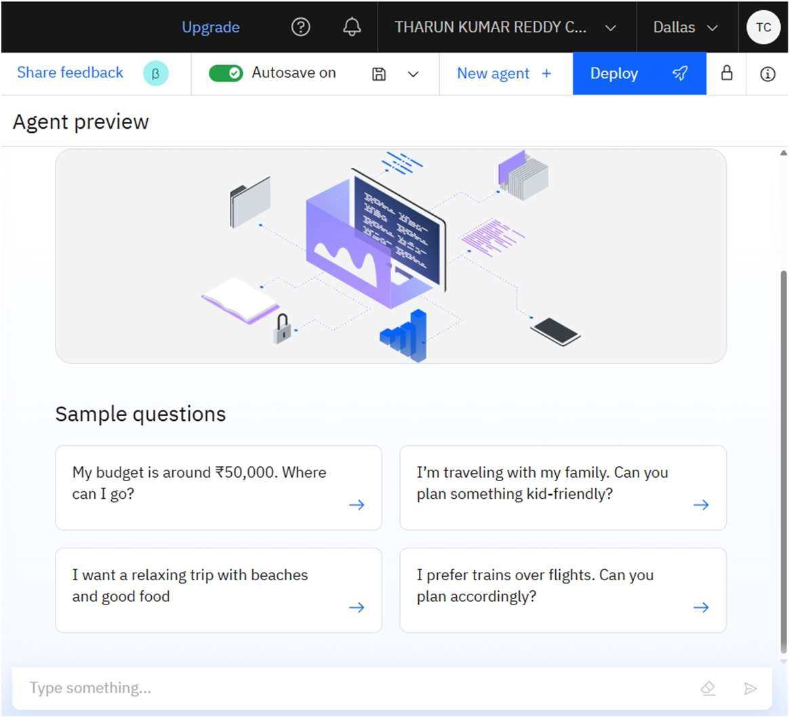
RESULTS

Slide 16
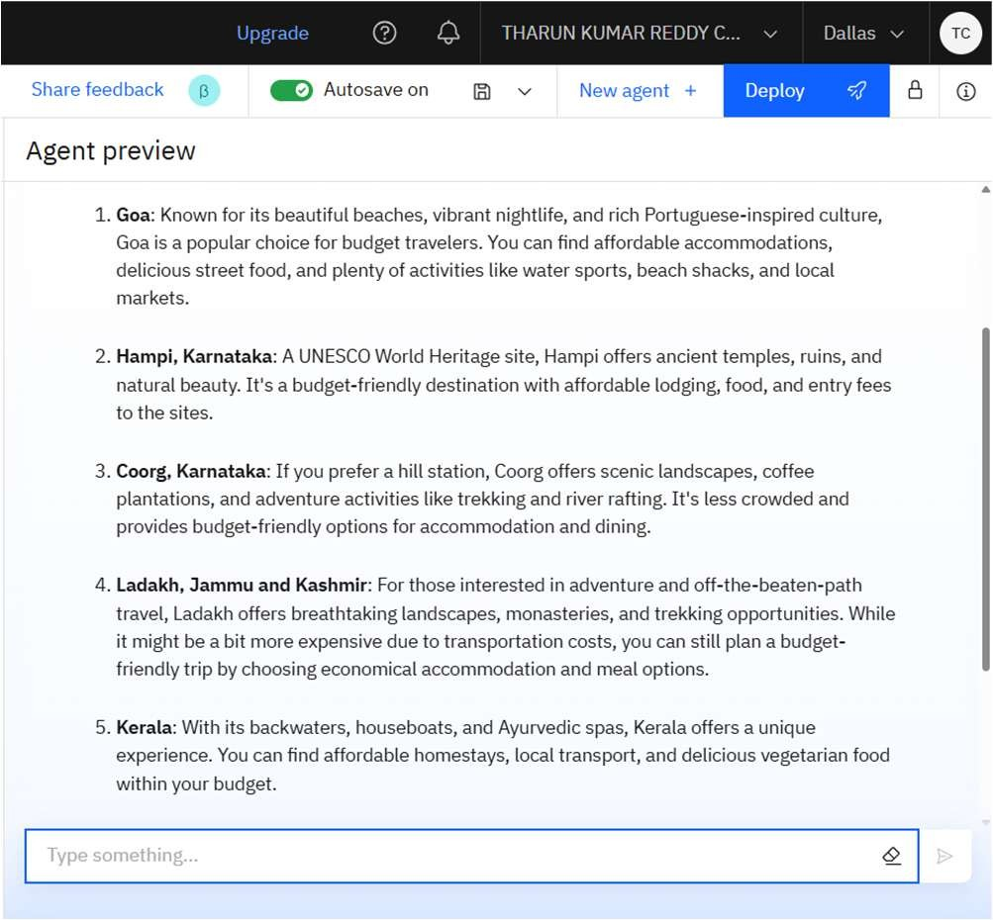
RESULTS

Slide 17
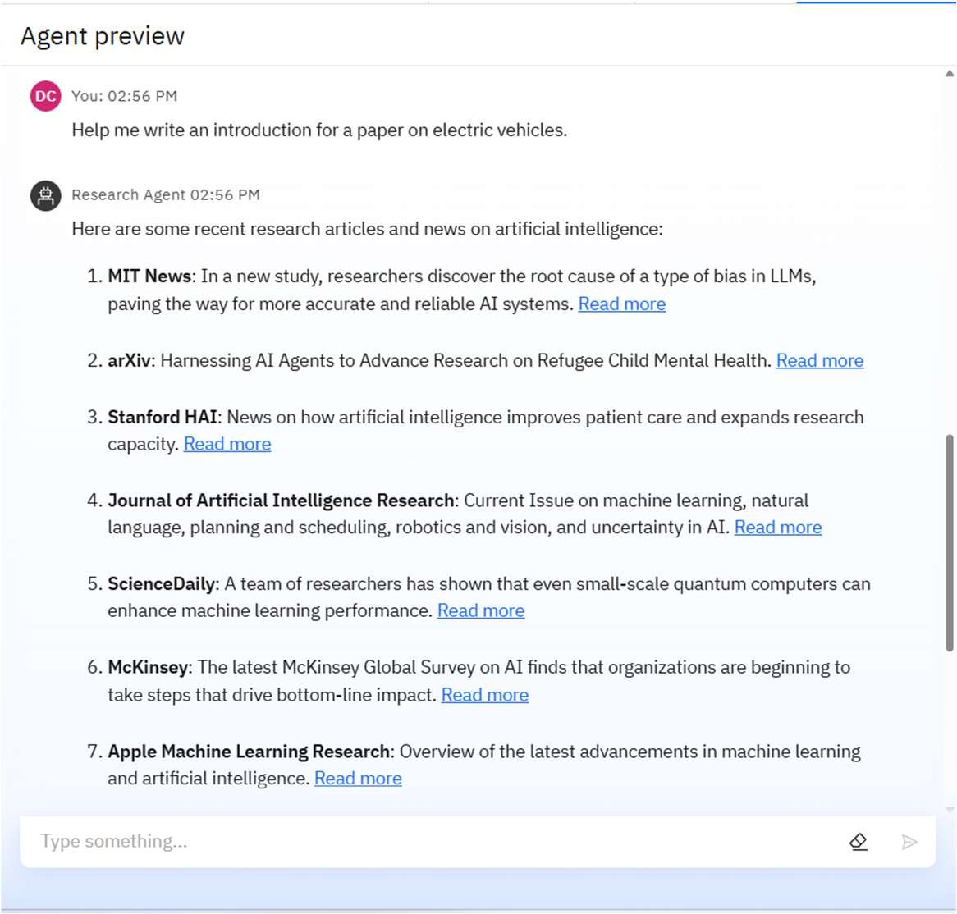
RESULTS

Slide 18
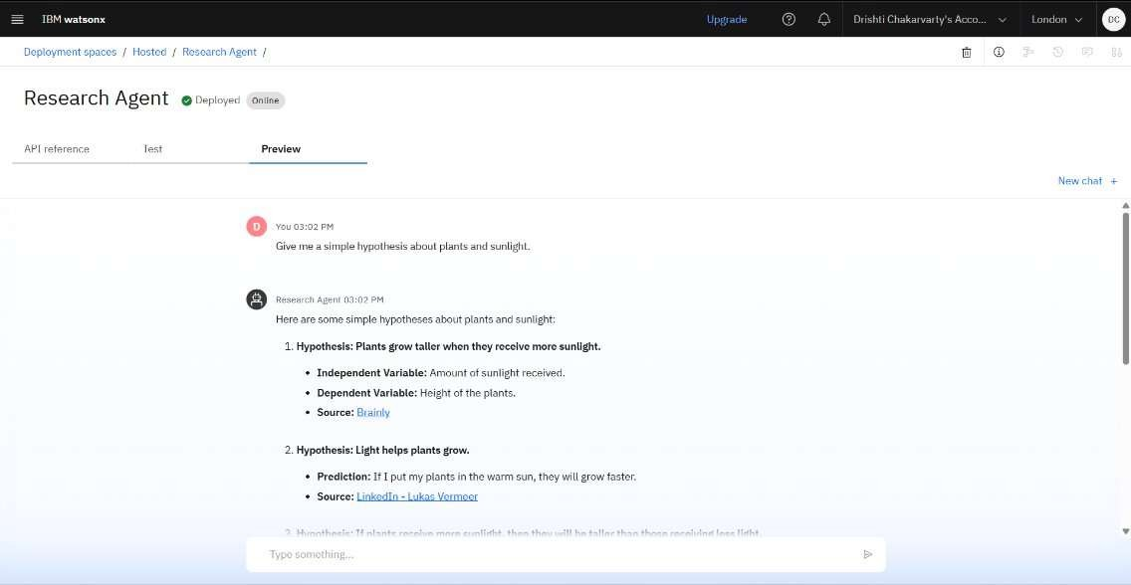
RESULTS
Deployed AI Agent

Slide 19
CONCLUSION
The Travel Planner Agent significantly reduces the complexity of planning a trip.
By leveraging IBM Cloud AI services, the agent delivers real-time, personalized, and adaptive travel solutions, helping users enjoy a well- organized journey.
It shows the practical application of AI in solving real-life logistical challenges while keeping the experience user-friendly and efficient.

Slide 20
GITHUB LINK
https://github.com/PrithviRajPatel/TRAVEL-PLANNER-AI-AGENT-PROJECT

Slide 21
FUTURE SCOPE
Voice Assistant Integration (Alexa, Siri, etc.)
Multilingual Travel Support with Watson Language Translator
Integration with Booking Platforms (e.g., Skyscanner, Airbnb)
Emergency Support Services (based on location & alerts)
Offline Mode Access for remote areas with low connectivity
AR-Based Virtual Destination Previews
AI Budget Optimizer to fit best experience under a user’s budget
Travel Community Features – recommendations from other users

Slide 22
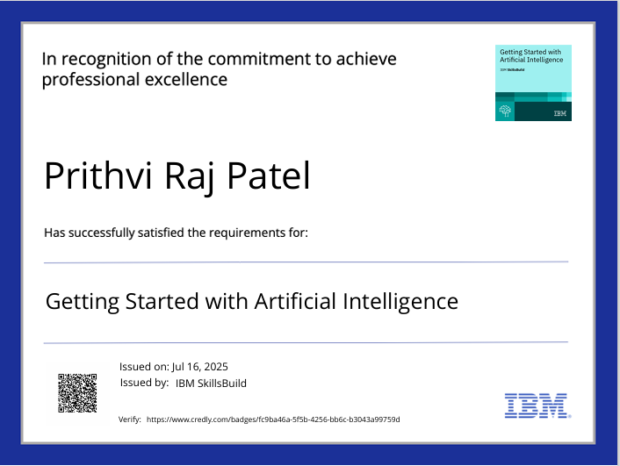
IBM CERTIFICATIONS

Slide 23
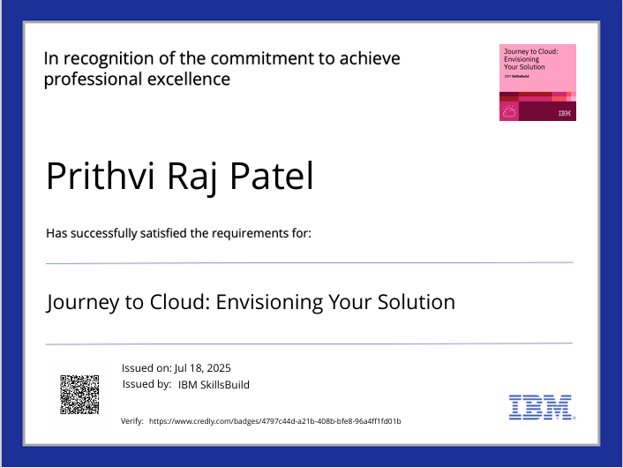
IBM CERTIFICATIONS

Slide 24
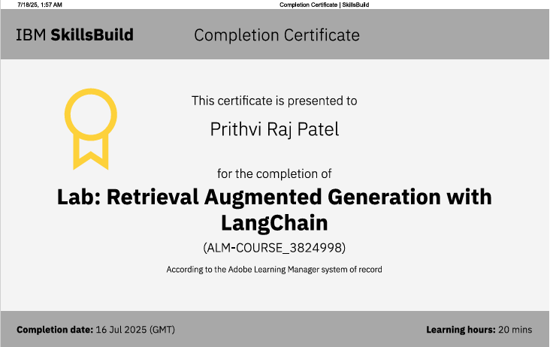
IBM LAB CERTIFICATE

Slide 25
THANK YOU

